Slide 1

How we help to connect the world and protect the planet

Slide 2
ANDREW® has a mission—and a responsibility
ANDREW, AN AMPHENOL COMPANY
Your goals are our goals
We build outdoor and indoor wireless connectivity solutions that support our MNO partners’ sustainability goals through a holistic design and manufacturing approach that:
Wireless mobile networks enable connectivity for our on-the-go world, enabling billions of people to conduct the business of their digital lives indoors and out. But this freedom can come with a cost—wireless networks consume a great deal of energy and other resources, which has a direct impact on the health of our environment and our planet.
Reduces the need for finite resources like aluminum, copper, steel and other energy-intensive refined materials
Modifies packaging to reduce the number of shipping containers needed to move our solutions across the seas
ANDREW’s industry-leading wireless infrastructure solutions are trusted by mobile network operators (MNOs) all over the world because our approach to innovation embraces the idea of building smaller, smarter and more efficient.
Never stops innovating new ways to get more RF performance for less energy in every product
The combined result is a complete portfolio of high-performance wireless network solutions that can significantly reduce CO₂ release over their operational lifetimes—and we have the data to prove it.
ANDREW at a glance

Slide 3

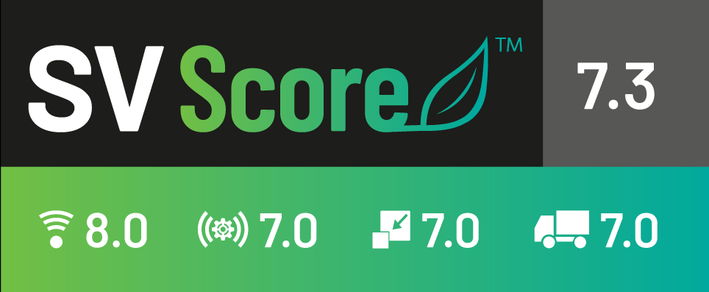

ANDREW, AN AMPHENOL COMPANY
Radiation efficiency measuring how much power put into an antenna translates directly into radiated signal
The science of sustainability by the numbers
Spatial efficiency
measuring how effectively the antenna covers a specific area without creating interference in other areas
It’s an unfortunate truth that, for some, sustainability is more talk than action. ANDREW’s commitment to sustainable practices across our business requires more of us than noble words—it requires hard numbers.
In 2023, we introduced our SVScore®, sustainability value score, the efficiency ranking for select products across four objective metrics on a scale of 1 to 10:
Materials use
a digest of the steel, copper, aluminum, fiberglass and thermoplastic used in construction, expressed in CO₂ equivalents (CO₂ eq), plus the recyclability of the product
Transportation efficiency
reflecting packaging volume and the energy and CO₂ eq saved by using less packaging or fewer shipping containers to transport
Introduced to quantify the sustainability profile of our base station antennas, the SVScore label is being expanded to cover more of our products every year.

Slide 4


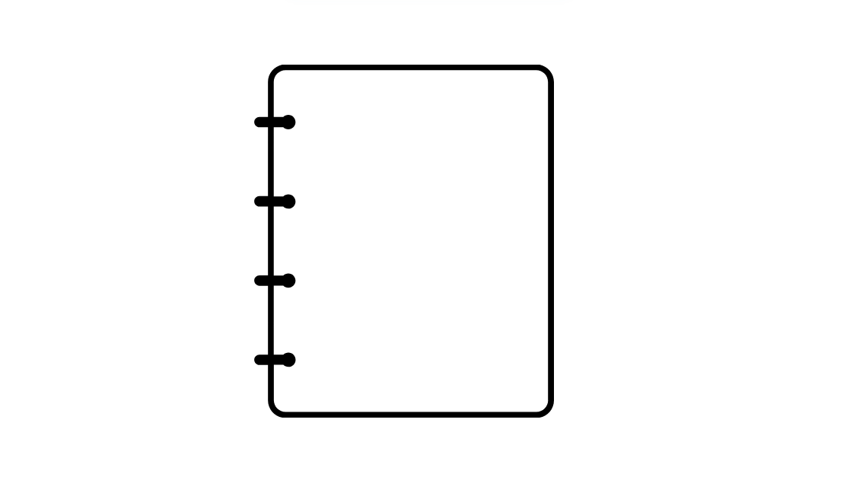



ANDREW, AN AMPHENOL COMPANY
Real progress—real results
Our sustainability journey has come a long way in helping us understand how our business affects the environment, and how we can do things better to minimize our impact while still helping the world connect.
2023 | 2024 | 2025 | 2030
Greenhouse gas (GHG) emissions for scopes 1 and 2
Achieved 21% emission reduction compared to 2022 (target was 5%) and 38% compared to 2019 baseline (target was 30%)
Lifecycle Assessment (LCA)
Completed 1 LCA base station antenna and 1 LCA for filters products families
Science-target definition
Set new SBT objectives and defined associated abatement strategy
Recycled raw materials
Continue implementation of recycled raw materials
Introduced SVScore® (Sustainability Value Score)
To measure the environmental impact of our base station antennas (BSA)
Recycled raw materials
Launched project to increase the use of recycled raw materials in our products. Assessment of the current situation done and implementation ongoing.
Refurbishment service
Continue refurbishment service deployment
Lifecycle Assessment (LCA)
Completed 7 LCAs for BSA, HELIAX solutions and structural support solutions
Refurbishment service
Launched new service on decommissioned base station antennas and filters products to extend their lifespan.
Greenhouse gas (GHG) emissions for scopes 1 and 2
Continue reduction plan with priority on process gas and renewable energies
Greenhouse gas (GHG) emissions for scopes 1 and 2
Achieve SBTi approved targets

Slide 5




ANDREW, AN AMPHENOL COMPANY
Our four pillars to support the circular economy
ECO-FRIENDLY DESIGNS
The concept of circular economy is a thoughtful approach to reducing waste and extending utility across the lifecycle of a product. It includes smarter sourcing of materials, more thoughtful processing, more efficient operation, longer operational lives and improved recyclability or repurposing of old products.
For ANDREW, supporting the circular economy rests on four pillars that promote sustainability, performance and overall network efficiency at the same time:
EXTENDING SOLUTION LIFECYCLES
CIRCULAR
ECONOMY
SUSTAINABLE MANUFACTURING PROCESSES
Eco-friendly design that reduces the use of CO₂ intensive refined minerals
Sustainable operations in manufacturing and across the supply chain
Rethinking packaging and logistics to reduce CO₂ release during transportation
Extending the lifecycle of our products to help MNOs defray high-impact upgrades
RETHINKING PACKAGING AND LOGISTICS

Slide 6
ANDREW, AN AMPHENOL COMPANY
EXTENDING SOLUTION LIFECYCLES
ECO-FRIENDLY DESIGNS
Objective: Extend our solutions lifecycles to maintain the value of products and material as long as possible
Guiding principles:
Optimize the end of fife (EOL) treatment of our products
Offer new services to our customers to extend the lifespan of their products: refurbishment service for old base station antennas and filters
Objective: Design eco-friendly products for more efficient networks through a smart use of resources
Guiding principles:
Realization of Life Cycle Assessment (LCA) to understand how our products impact environment at all stages of their lifecycle: LCA factsheets
Design optimization for weight reduction
Use of eco-friendly materials: recycled and recyclable materials
Development of new tools to help our customers assess the environmental impact of our products like our SVScore
Design in compliance with regulations on product’s content: RoHS, REACH, Restricted Substance, …
Support our customers decarbonization journey in their network design and modernization by proposing energy efficient products that fit their needs, e.g. SEED antennas, ERA system, and more.
ANDREW GREEN AGENDA FOR SUSTAINABILITY
RETHINKING PACKAGING AND LOGISTICS
SUSTAINABLE MANUFACTURING PROCESSES
Objective: Reduce distribution impacts by optimizing packaging and transportation
Guiding principles:
Design packaging solutions that enable transportation efficiency by increasing container loading rate
Use packaging that eliminate or minimize the use of Single-use plastics and non-recyclable materials
Remove paper documentation by implementing digital documentation
Objective: Reduce GHG emissions in our manufacturing plants and in our suppliers' facilities
Guiding principles:
Reduce the energy used during manufacturing operations at suppliers’ facilities and in our internal plants
Transition to renewable energies
Implement Single Use Plastics free requirement in our supply chain
Certify manufacturing sites to the ISO 14001 standard

Slide 7



ANDREW, AN AMPHENOL COMPANY
Eco-friendly designs reduce CO₂ emissions
Mining and refining minerals like copper and aluminum take a heavy toll on the environment. It’s destructive to ecosystems and requires a great deal of energy to process. ANDREW makes it our priority to reduce the use of these materials as much as possible, while still providing exceptional performance. With every ton of CO₂ equivalent (CO₂ eq) prevented, we lighten our footprint on the environment.
Creating an eco-friendlier coaxial cable design
In 2024, we redesigned the protective plastic covers on our popular LDF4 and FSJ4 coaxial cabling solutions, reducing thickness without compromising quality.
New design results in the prevention of 40 kg of CO₂ eq per 1,000 units manufactured
Replacing steel to reduce environmental impact
We found a way to replace steel cable supports with equally-capable plastic alternatives, reducing the amount of mined materials used.
2.62 kg steel supports were replaced by 0.8 kg plastic, a 70% reduction in overall weight on the tower
The change in material saves 3.2 metric tons of CO₂ eq per 1,000 units manufactured
A more energy-efficient way to provide indoor coverage and capacity
Our all-digital ERA® digital DAS reduces the energy needed to cover large public venues by eliminating the need for analog remote radio units in the headend. A recent deployment at a large NFL stadium made a significant difference:
DAS power consumption was reduced by 87% over the older system
This translated into more than 100 metric tons of CO₂ emissions prevented annually
The compact ERA headend also freed up 5,000 square feet of space
Reducing the complexity and environmental impact of indoor coverage using ERA
Our ERA DAS platform reduces the environmental impact of covering large public venues by utilizing an all-digital architecture that eliminates the need for remote radio units (RRU’s) in the head end, along with other analog RF components like RF attenuators and RF distribution cabling.
These components in themselves have a high environmental impact both from the materials that are used to manufacture them, and the power they consume/dissipate.

Slide 8
ANDREW, AN AMPHENOL COMPANY
Eco-friendly designs deliver improved energy efficiency
Beyond the environmental impact of sourcing raw materials, the ongoing energy use and CO₂ footprint created by years of operation in the field is a critical metric of sustainability.
ANDREW thinks outside the box to create a diverse and innovative suite of solutions to mitigate operational energy use—not only in how it’s used, but also in how it’s sourced and delivered.
Feeding cell sites with renewable energy—even off the grid
We offer a solution that integrates vertical wind turbines and solar panels to power macro cell sites.
Renewable solution can provide up to 50% of a cell site’s energy needs
Prevents the release of 48 metric tons of CO₂ emissions yearly
Reduces the need for gasoline-powered refueling of generators for remote cell sites
Can fully power macro sites in optimal conditions
Reducing line losses with smart power delivery
Our PowerShift® Macro solution dynamically boosts DC voltage to remote radios for greater efficiency.
Intelligent power management supports high-power remote radio units
Requires less robust cabling to deliver efficient voltages
Defrays or eliminates the need for cabling upgrades over time
Reduces the need for additional backup battery strings and helps ensure maximum service life of older battery strings

Slide 9
ANDREW, AN AMPHENOL COMPANY
Eco-friendly designs deliver improved energy efficiency
Slashing power use with super-efficient BSA technology
Our proprietary SEED® (Sustainable Energy-Efficient Design) technology is now available in select base station antennas.
Advanced phase shifter technology boosts the antenna’s radiated power relative to its input power
SEED allows MNOs to provide the same coverage from a given site while consuming up to 15% less power
Alternately, MNOs can provide up to 15% wider coverage from the site at its original power level
Wider coverage can reduce the need for additional sites—and the environmental impact that comes with them
Covering indoor spaces and conserving energy use
The ERA® all-digital DAS platform brings powerful 5G coverage indoors thanks to its innovative design.
The ERA platform requires no energy-intensive analog-to-digital conversion in signal processing
The ERA platform operates on standard IT cabling and can share infrastructure with other applications
Access points are available in a range of power levels to prevent energy waste
Its compact headend requires 90% less space—and up to 55% less cooling resources than other DAS solutions
Smoothing and scaling the evolutionary path of MIMO in wireless networks
ANDREW solutions give MNOs the freedom and flexibility to deploy in stages, reducing waste and costs.
Our antennas support 4G and 5G networks with 4T4R/4T8R and FDD 8T8R, respectively—providing a clear and reliable migration path as needs change
8T8R provides sufficient capacity for all but the highest traffic environments
8T8R uses 30% less power than 32T32R, and 50% less power than 64T64R

Slide 10


ANDREW, AN AMPHENOL COMPANY
Reducing and recycling in our manufacturing
We embarked on an organization-wide review of operations in 2023, yielding significant sustainability benefits.
Replacing diesel forklifts in our operations with electric ones prevented the release of 1.8 metric tons of CO₂ eq
Recycling solder dross enabled us to reclaim 30% of the solder expended—and prevented the release of 20 metric tons of CO₂ eq
Improving electrical efficiency and cutting fossil fuel use
Our large manufacturing plant in Goa, India implemented big changes in 2024, with measurable effects.
Insulation line and extruder controls were converted from DC to more efficient AC power, saving enough electricity to prevent release of 27.1 metric tons of CO₂ eq
Redesigned oven, washing and paint systems reduced LPG consumption amounting to 4.2 metric tons of CO₂ eq
Sustainable operations are part of our manufacturing processes
Updating our facilities to the latest efficient systems
Our facility in Suzhou, China adopted several worthwhile changes in 2024 to reduce power use in their operations.
Installation of high-efficiency factory lighting reduced power consumption by 60%
HVAC system was updated to serve the facility while using 50% less power
Intelligent power transformers were able to adapt to changing power needs and reduce overall power consumption by 12%
Global manufacturers have a special responsibility to promote sustainable practices, not only in the products they sell, but also in the facilities and processes that bring those products to market. ANDREW embraces a wide variety of green priorities in our work and our workplaces, supporting the communities we live in—and the connected world we serve.
Harvesting rainwater to reduce impact on water supplies
We’re protecting our precious water resources and diverting waste to protect the communities where we work.
Our Goa, India facility installed a rooftop rainwater harvesting system to collect and reuse 4,622 cubic meters of water in 2024
This supported a 22% overall reduction in Goa’s water use, which also included reducing line pressure via modified pumping and additional storage tanks

Slide 11

ANDREW, AN AMPHENOL COMPANY
Rethinking packaging and logistics to reduce our carbon footprint
With 90% of the world’s commercial trade being moved on about 90,000 cargo ships and countless more in large trucks, ANDREW decided to move in a more sustainable direction. It takes a thoughtful, holistic approach to squeeze efficiencies out of something as big as global trade, but we’ve taken some important steps that make each delivery of ANDREW products a bit more earth-friendly.
Eliminating synthetic packing with some very clever cardboard
After using expanded polyethylene foam (EPE) to protect our family of RF filter products, we found some clever ways to ditch the plastic—with cardboard.
Full-carton packaging protects as well as EPE without the waste, cutting greenhouse gas (GHG) emissions by 70% on average and prevents release of 377 kg of CO₂ eq per 1,000 shipped
Molded fiber made of recycled material cut GHG emissions by 57% and prevents release of 210 kg of CO₂ eq per 1,000 shipped
Folded cardboard wraps securely and cuts GHD emissions by 61% and prevents 350 kg of CO₂ eq per 1,000 shipped
Finding a lighter way to protect fiber in transit
In 2024, we reimagined how we ship our fiber cabling to find a more sustainable way to protect these delicate products shipped from Goa, India and Reynosa, Mexico.
We replace hard-sided corrugated PVC tubing with a lighter-weight and less material-intensive foam tubing alternative
The new packaging prevents the release of 14 metric tons of CO₂ eq per 1,000 meters of shipped cable
Packing smarter and traveling lighter
A top-to-bottom redesign of our packing and logistics at our Goa, India facility led to some amazing improvements—without compromising quality.
New methods of handling our BSAs, HELIAX® solutions and microwave antennas improved our container utilization by as much as 16%
Prevented the use and shipping of about 250 containers
Fewer containers mean less fuel burned by cargo ships—in 2023, this meant an estimated 461 metric tons of prevented CO₂ eq
Optimizing our distribution network to reduce emissions
We consolidated the manufacturing output of our China facility in our distribution center in Europe to improve our shipping efficiency.
Consolidated freight by ship instead of by truck resulted in 1,500 km less distance traveled per container
Since July 2023, prevented CO₂ eq release due to fuel savings is estimated at 18.3 metric tons

Slide 12


ANDREW, AN AMPHENOL COMPANY
Giving MNOs the tools they need to evolve more responsible networks
We build solutions that empower scalability and evolution in wireless networks to reduce waste.
Our combined active/passive MOSAIC® antenna helps MNOs to add RAN technologies without replacing passive components
Our modular CMC equipment enclosures offer flexible thermal management and backup battery configurations
Building for the long term, whatever the application—and whatever the weather
ANDREW solutions offer superior reliability for longer, more flexible service life with less need for maintenance.
Our trusted HELIAX solutions come with 10-year warranties and are commonly in service for twice that long—or even longer.
Extending product lifecycles to reduce our impact
Repurposing and refreshing technology to keep it out of the landfill longer
We work with third parties to extend the life of legacy equipment and even refurbish our own.
In 2024, ANDREW became the first OEM to join the GSMA Equipment Marketplace, giving MNOs a reliable source of quality legacy equipment
We now enable our European customers to reuse decommissioned BSAs and filters
Our UK Services Team has refurbished more than 200 site cabins to like-new condition, using a fraction of the resources required to replace them with new equipment
When our products perform better for longer, it keeps those materials working hard on towers instead of occupying landfill space. Our MNO partners also understand the combined economic and environmental benefits of building a network that can age and evolve gracefully, preventing expensive and wasteful replacement as long as possible—and that’s why ANDREW builds with the future in mind.

Slide 13




ANDREW, AN AMPHENOL COMPANY
Extending useful material use through recycling
Protecting the antenna—and the environment
ANDREW proves that it’s possible to build a more effective product that is also more recyclable.
Our next-gen glass fiber reinforced polypropylene (GFRPP) antenna radome is made of 100% recyclable thermoplastic
20% reduced weight compared to older resin-based products saves steel that would be used for tower upgrades
Improved RF transparency: 65% reduced insertion loss
Wood pallet recycling in Goa (IN) - 184 metrics tons of pallets recycled in 2024
16.6 metric tons of CO₂eq saved in 2024
Making better use of available recycled materials
ANDREW is increasing our use of recycled raw materials all the time.
Nine lifecycle assessments (LCAs) have been completed to date, informing our recycling strategy
ANDREW is working with suppliers to increase the use of recycled raw materials
Aluminum is the most pressing priority, to be followed by steel and copper in 2025
90 metric tons of wood reels reused in Reynosa (MX)

Slide 14


ANDREW, AN AMPHENOL COMPANY
Our partners have important sustainability goals to fulfill. ANDREW is 100% committed to helping them reach those goals because, like them, we understand that connecting the world can—and must—be accomplished while protecting the planet.
ANDREW’s commitment is solid rock

Slide 15
©2025 ANDREW, an Amphenol company. All rights reserved. Amphenol and ANDREW are registered trademarks of Amphenol and/or its affiliates in the U.S. and other countries. All product names, trademarks and registered trademarks are property of their respective owners. CO-200163-EN Feb 2025

